Slide 1

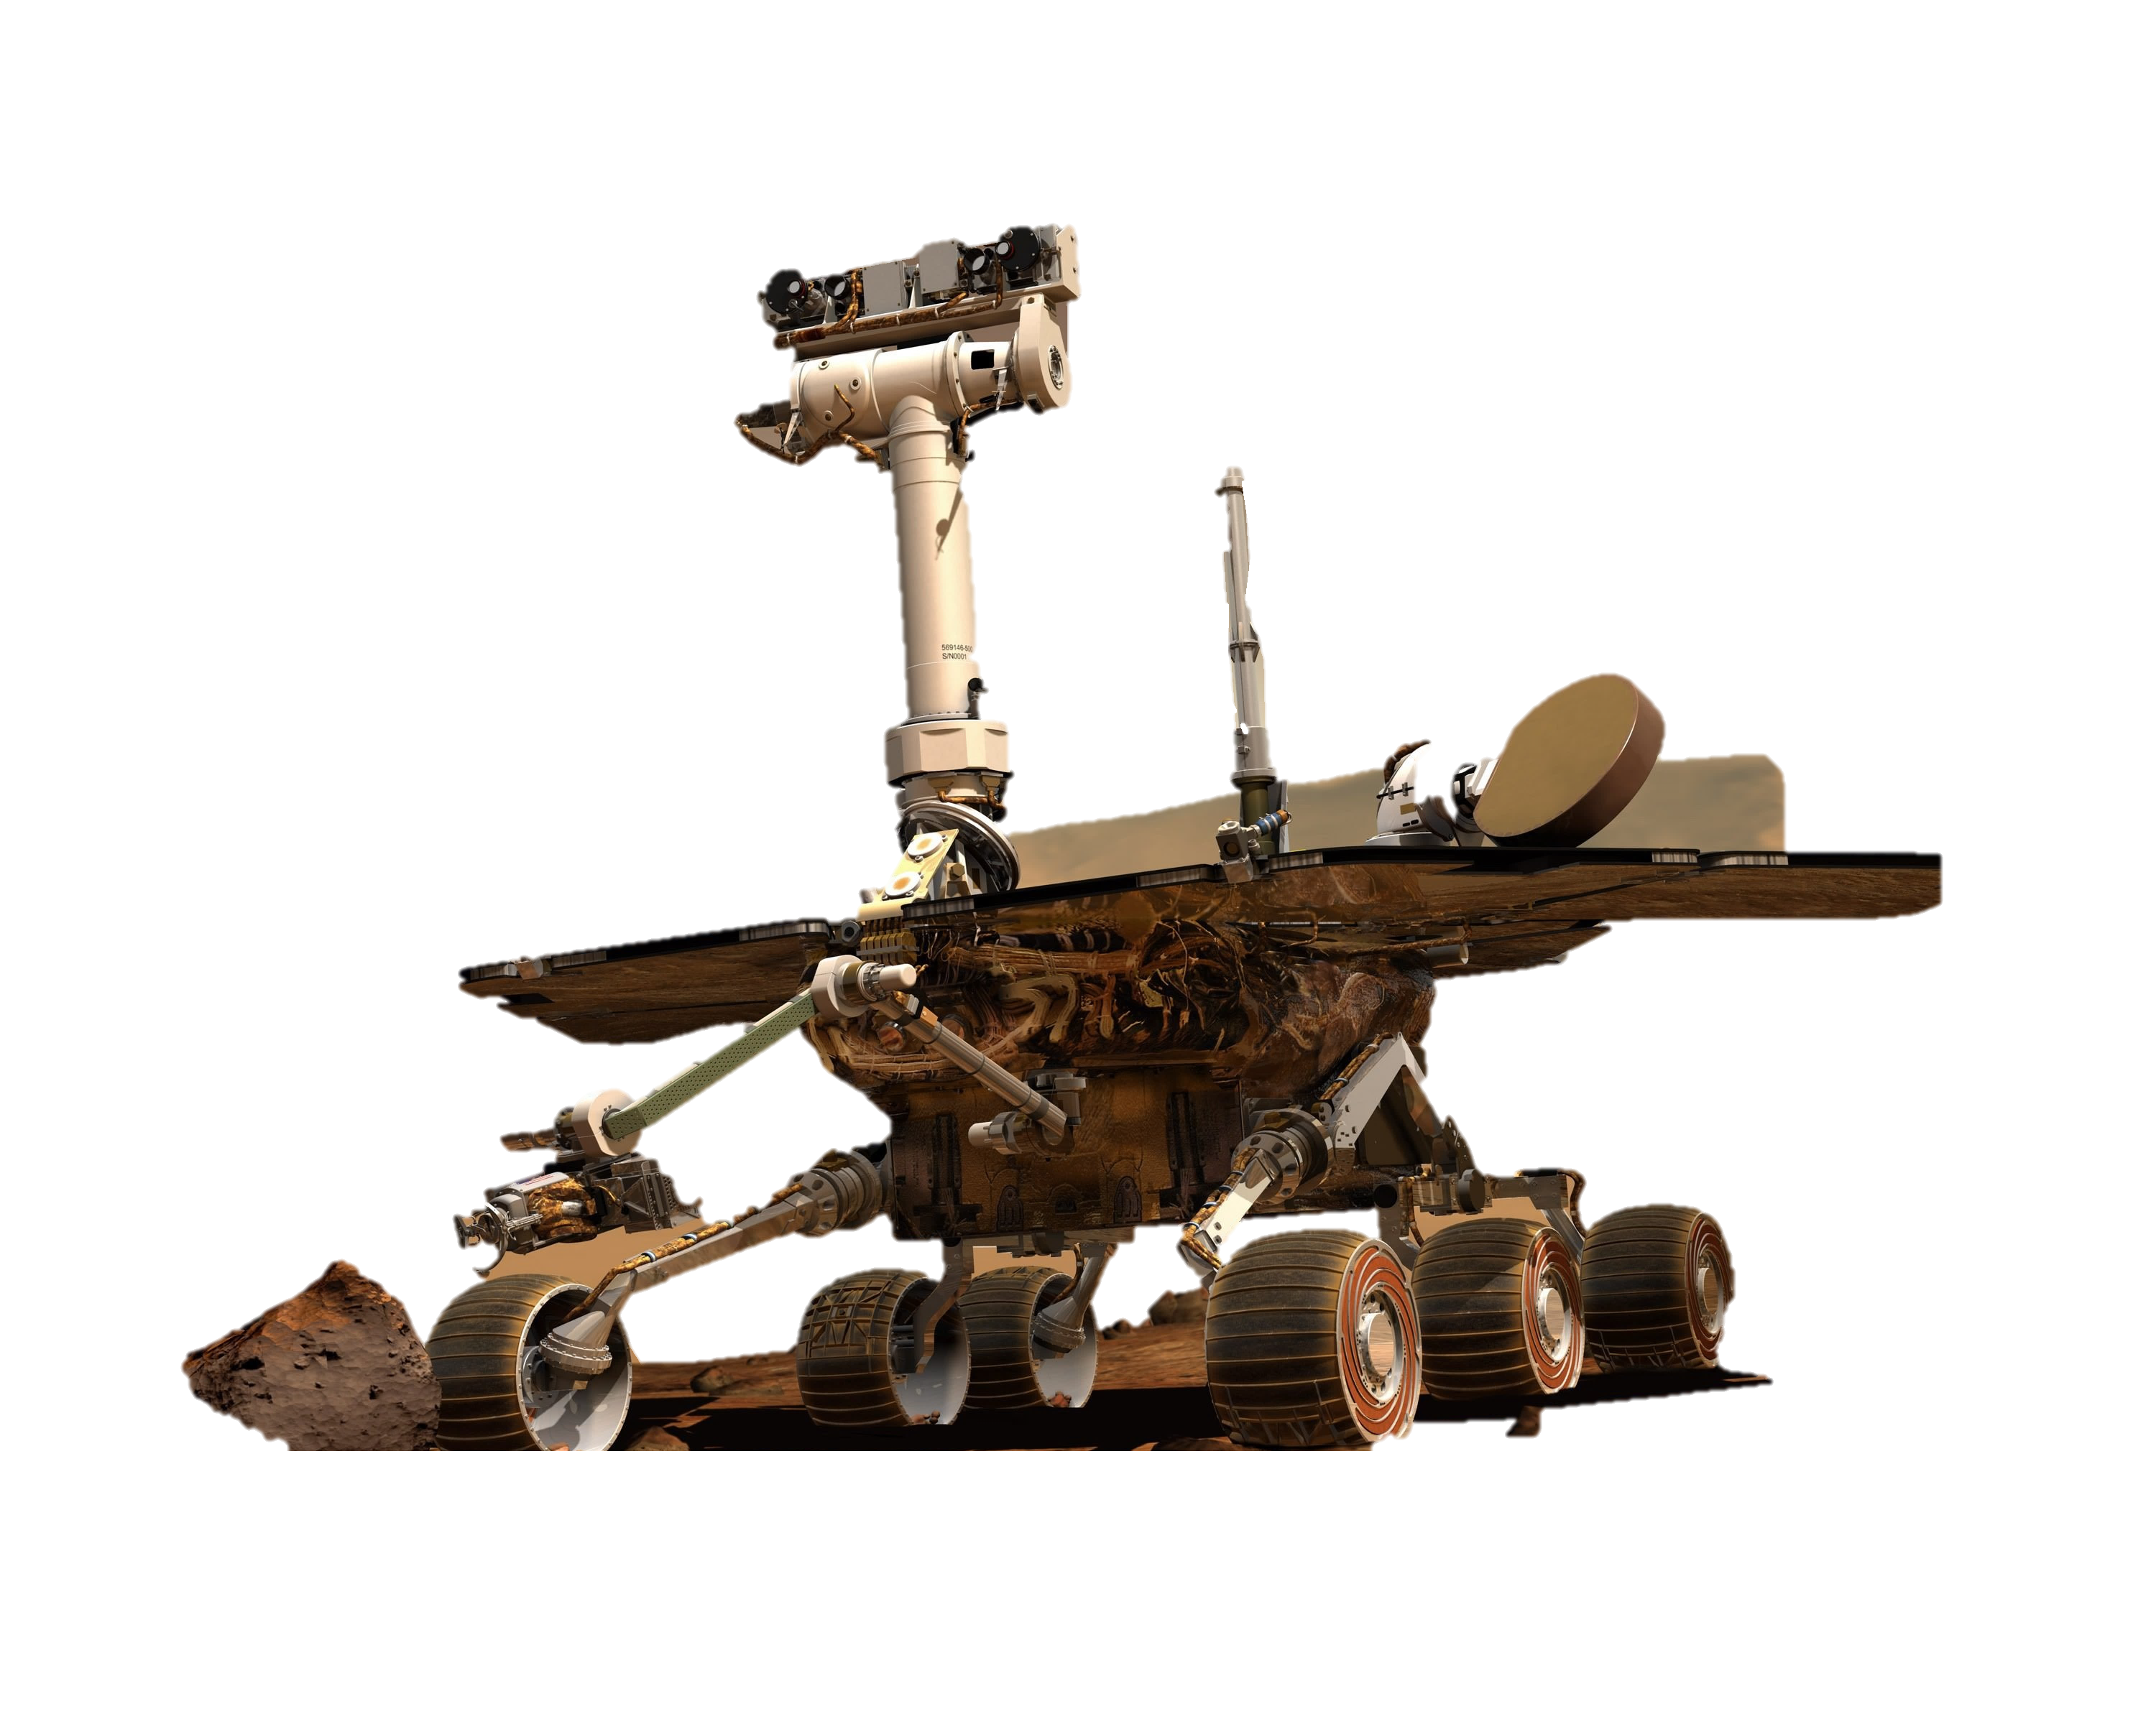
WELCOME
To My Presentation

Slide 2


VISUALIZATION
To My Presentation

Slide 3
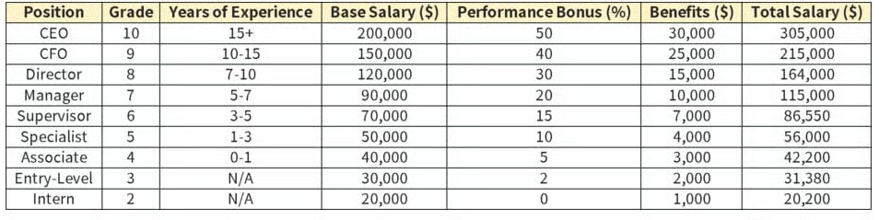
INTRODUCTION TO DATA VISUALIZATION
What is Data Visualization?
Data Visualization means converting raw data into visual forms like charts, graphs, maps, and dashboards so that information becomes easier to understand.
Simple Explanation:
Instead of reading a long table of numbers, we show the same information in a bar chart or line chart.
Example
A table showing position-based salary may be boring:
But a line chart immediately shows the trend — increasing, decreasing, up-down pattern.
Charts = Fast understanding Tables = Slow understanding

Slide 4
IMPORTANCE OF DATA VISUALIZATION
Quick Understanding
Better Decision Making
Finding Patterns & Trends
Detecting Outliers / Unusual Points
Communication & Presentation

Slide 5
Good Visualizations
Bad Visualizations
Too many colors
Wrong chart type
Misleading axes
Too much text
3D charts (misleading size perception)
Simple
Clean
Right chart type
Easy to read
Proper colors
Proper labels & titles

Slide 6
Good Visualizations
Bad Visualizations
Too many colors
Wrong chart type
Misleading axes
Too much text
3D charts (misleading size perception)
Simple
Clean
Right chart type
Easy to read
Proper colors
Proper labels & titles

Slide 7
TYPES OF DATA To choose the correct chart, you must know the type of data.
Categorical Data
Numerical Data
Time Series Data
Geospatial Data
Hierarchical Data
Represents categories, not numbers.
Represents numbers.
Data collected over time.
Data related to locations or maps.
Data with levels or parent-child relationships.

Slide 8
PRINCIPLES OF EFFECTIVE VISUALIZATION
Data-Ink Ratio
Chartjunk (What to Avoid)
Choosing the Right Chart
Color Theory
Using Size, Shape, Position, and Length
Storytelling With Data
How Humans Perceive Visual Information
maximum ink should show actual data, and minimum ink should be used for decoration.
Chartjunk = Junk elements in a chart.
Choosing the correct chart is 50% of good visualization.
Colors help understanding, but too many colors create confusion.
Humans understand position and length fastest.
Data visualization is not just charts it is storytelling.
Human brain processes images 60,000x faster than text.

Slide 9
PRINCIPLES OF EFFECTIVE VISUALIZATION
Principle | Meaning | Bad Example | Good Example
Data-ink ratio | Reduce decoration | 3D chart | Simple bar chart
Chartjunk | Avoid unnecessary items | Icons, patterns | Clean chart
Choosing right chart | Chart must match data | Pie for trend | Line for trend
Color theory | Use meaningful colors | Rainbow | 3–5 calm colors
Size/shape/position | Emphasize readability | Big bubbles | Equal-sized bars
Storytelling | Explain insights | No commentary | Key insights/notes
Human perception | Use simple visuals | Small text, 3D | Simple 2D charts

Slide 10
CHART TYPES
COMPARISON CHARTS
DISTRIBUTION CHARTS
RELATIONSHIP CHARTS
COMPOSITION CHARTS
TREND CHARTS
RANKING CHARTS
MAPS (Geographical Visualization)\

Slide 11
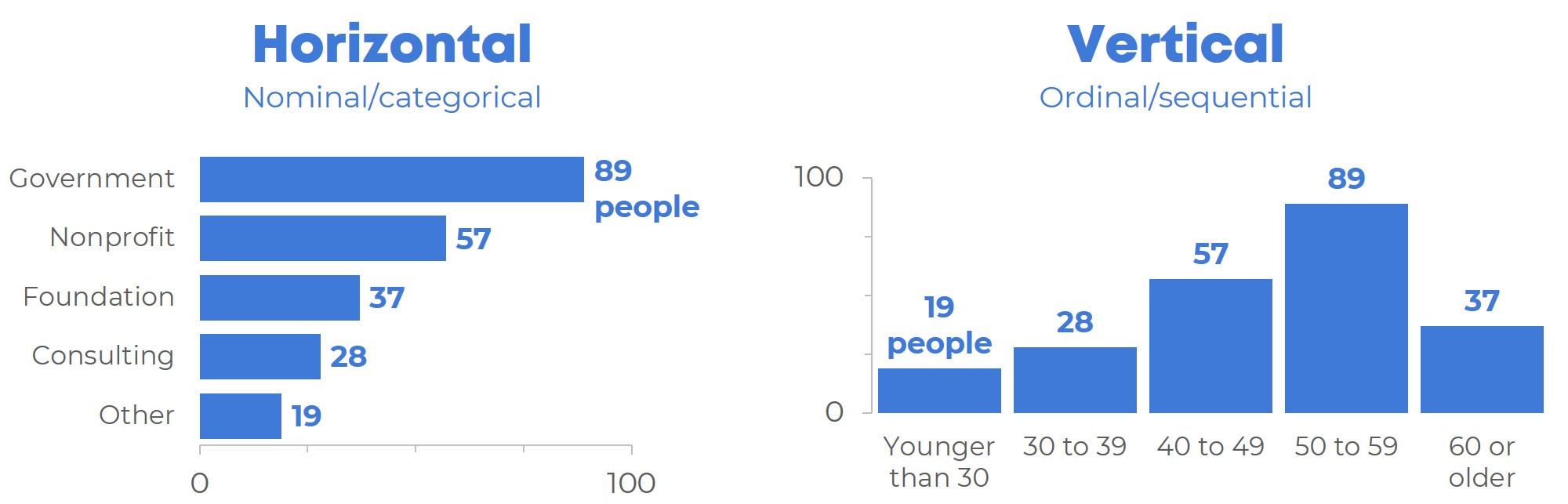
COMPARISON CHARTS
Bar Chart (Vertical/Horizontal)
What it is: | Bars used to compare categories.
When to use: | Compare values across categories. Showing differences between groups.
Why to use: | Easy to compare lengths → quick understanding.
Real-life examples: | Sales of products Students in different departments Revenue from multiple regions

Slide 12
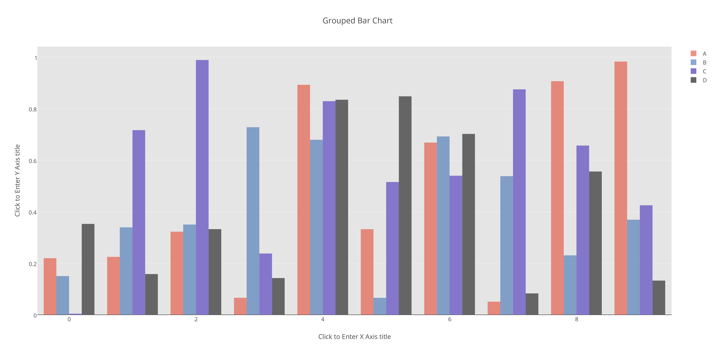
COMPARISON CHARTS
Grouped Bar Chart
What it is: | Multiple bars grouped together for each category.
When to use: | Compare sub-categories within main categories.
Why to use: | Shows differences between groups in one chart.
Real-life examples: | Sales of (Product A, B, C) across months Boys' vs Girls across classes

Slide 13
COMPARISON CHARTS
Stacked Bar Chart
What it is: | Bars stacked on top of each other showing parts of whole.
When to use: | Show total + contribution of each sub-category.
Why to use: | Shows composition + comparison at same time.
Real-life examples: | Expenses split into Rent, Food, Travel Revenue split by products per month

Slide 14
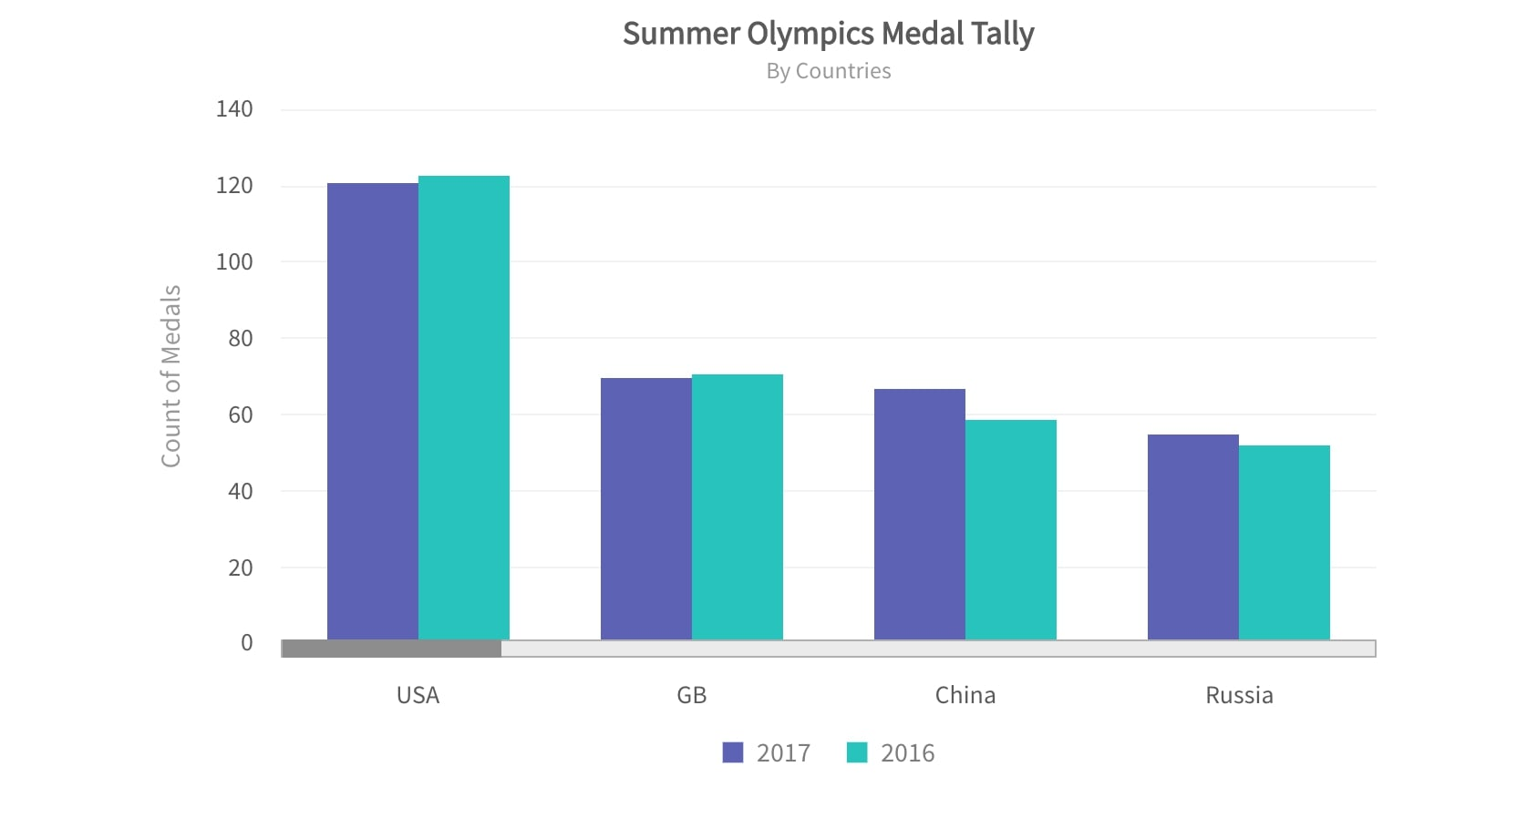
COMPARISON CHARTS
Column Chart
What it is: | Vertical version of bar chart.
When to use: | Comparing values over time Presenting trends with categories
Why to use: | Height is easier for people to read.
Real-life examples: | Monthly profit Yearly population growth

Slide 15
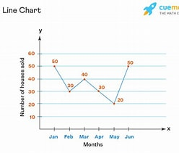
COMPARISON CHARTS
Line Chart
What it is: | A series of data points connected with lines.
When to use: | Tracking trends over time (days, months, years).
Why to use: | Shows trends, rises, and drops clearly.
Real-life examples: | Stock market price Temperature across months Website traffic over time

Slide 16
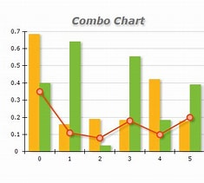
COMPARISON CHARTS
Combo Chart (Line + Bar)
What it is: | Combination of bar and line.
When to use: | Compare two different datasets One metric measured with bars, one with line
Why to use: | Shows correlation between two values.
Real-life examples: | Sales (bar) vs Profit % (line) Revenue (bar) vs Expenses (line)

Slide 17
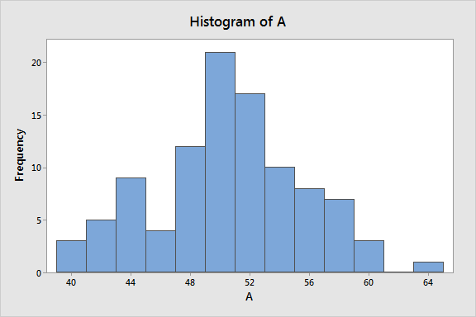
DISTRIBUTION CHARTS
Histogram
What it is: | Chart showing frequency distribution of numeric data.
When to use: | Understand data distribution Check skewness, normality
Why to use: | Shows how data is spread across ranges.
Real-life examples: | Age distribution Salary distribution Marks distribution

Slide 18
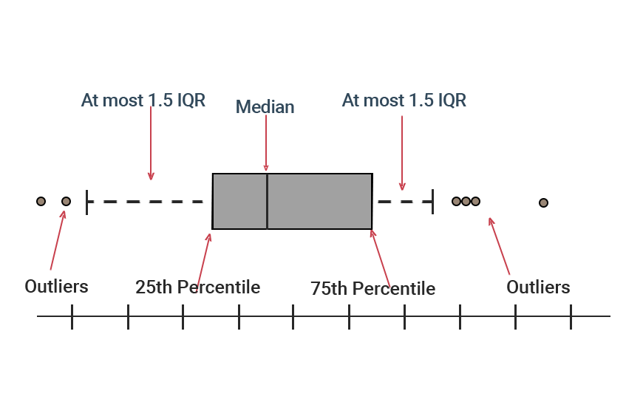
DISTRIBUTION CHARTS
Box Plot
What it is: | Chart showing median, quartiles, and outliers.
When to use: | Detect outliers Compare multiple groups
Why to use: | Gives summary of distribution in one chart.
Real-life examples: | Salary comparison across roles Height distribution of boys vs girls

Slide 19
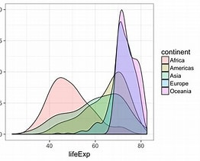
DISTRIBUTION CHARTS
Density Plot
What it is: | Smoothed version of histogram.
When to use: | Show distribution smoothly Compare distributions
Why to use: | Better visual for continuous probability distribution.
Real-life examples: | Income distribution Customer age distribution

Slide 20
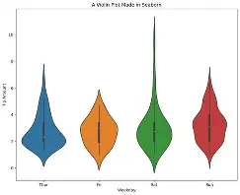
DISTRIBUTION CHARTS
Violin Plot
What it is: | Combination of box plot + density plot.
When to use: | Compare distributions in multiple groups.
Why to use: | Shows data shape + quartiles + density.
Real-life examples: | Test score comparison Salary comparison across departments

Slide 21
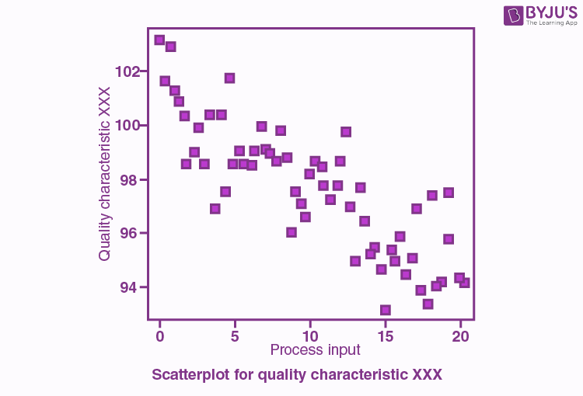
DISTRIBUTION CHARTS
Scatter Plot
What it is: | Points showing relationship between two variables.
When to use: | Find patterns, relationships Detect correlation
Why to use: | Shows how two variables move together.
Real-life examples: | Height vs Weight Sales vs Advertising spend

Slide 22
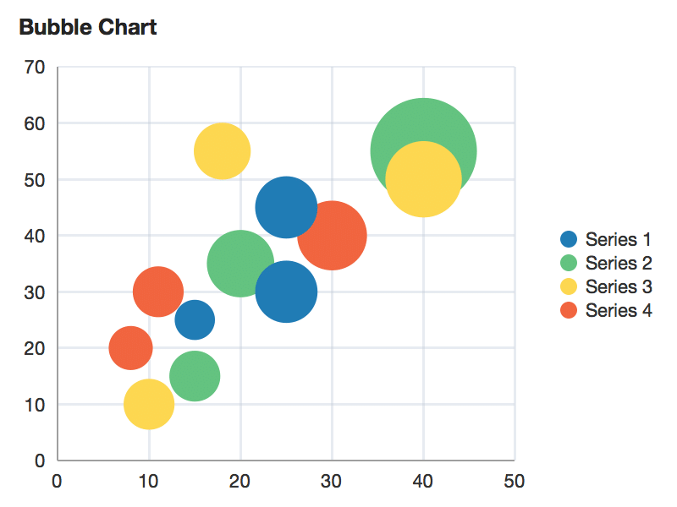
DISTRIBUTION CHARTS
Bubble Plot
What it is: | Scatter plot with bubble size representing another metric.
When to use: | 3 variables in one chart.
Why to use: | Shows relationship + importance via size.
Real-life examples: | Country GDP (size), Population, Income Marketing cost vs leads vs conversion rate

Slide 23
RELATIONSHIP CHARTS
Scatter Plot
What it is: | Points showing relationship between two variables.
When to use: | Find patterns, relationships Detect correlation
Why to use: | Shows how two variables move together.
Real-life examples: | Height vs Weight Sales vs Advertising spend

Slide 24
RELATIONSHIP CHARTS
Bubble Plot
What it is: | Scatter plot with bubble size representing another metric.
When to use: | 3 variables in one chart.
Why to use: | Shows relationship + importance via size.
Real-life examples: | Country GDP (size), Population, Income Marketing cost vs leads vs conversion rate

Slide 25
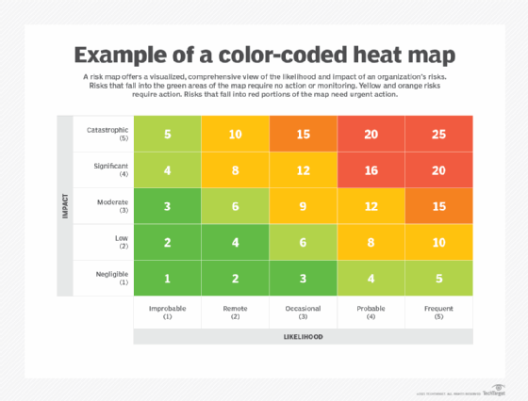
RELATIONSHIP CHARTS
Heatmap
What it is: | Matrix of values shown through colors.
When to use: | Show intensity Correlations Large datasets
Why to use: | Easy to identify high/low zones via colors.
Real-life examples: | Correlation matrix Attendance heatmap (months × days) Website activity heatmap

Slide 26
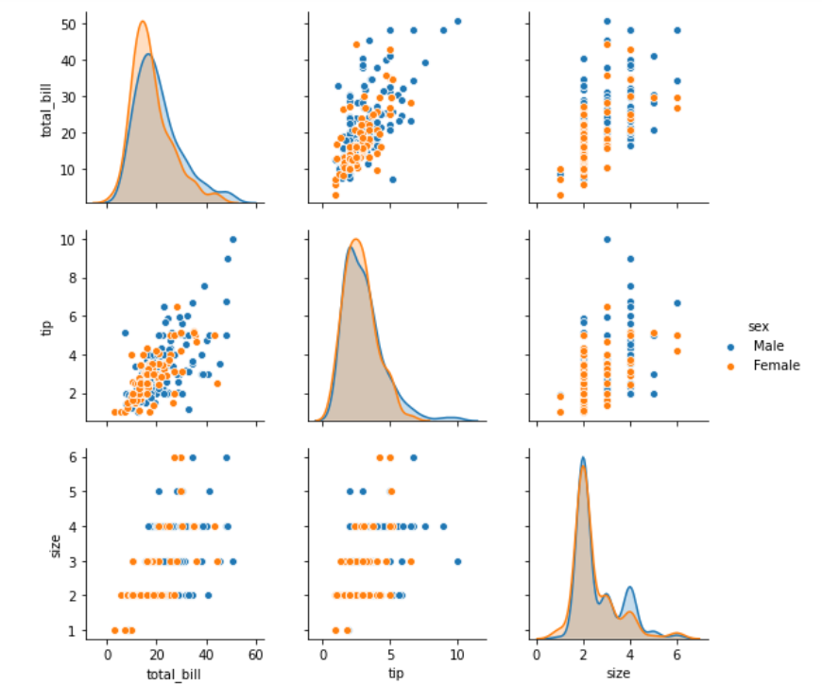
RELATIONSHIP CHARTS
Pair Plot
What it is: | Plot matrix showing relationships of all variable combinations.
When to use: | Exploratory Data Analysis Understand multiple relationships at once
Why to use: | Quickly identifies correlations.
Real-life examples: | Iris dataset (sepal/petal relationships) House price dataset

Slide 27
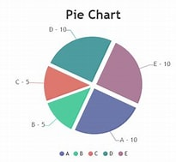
COMPOSITION CHARTS
Pie Chart
What it is: | Circle divided into slices.
When to use: | Show parts of a whole Small number of categories
Why to use: | Simple and commonly used.
Real-life examples: | Market share Budget allocation

Slide 28
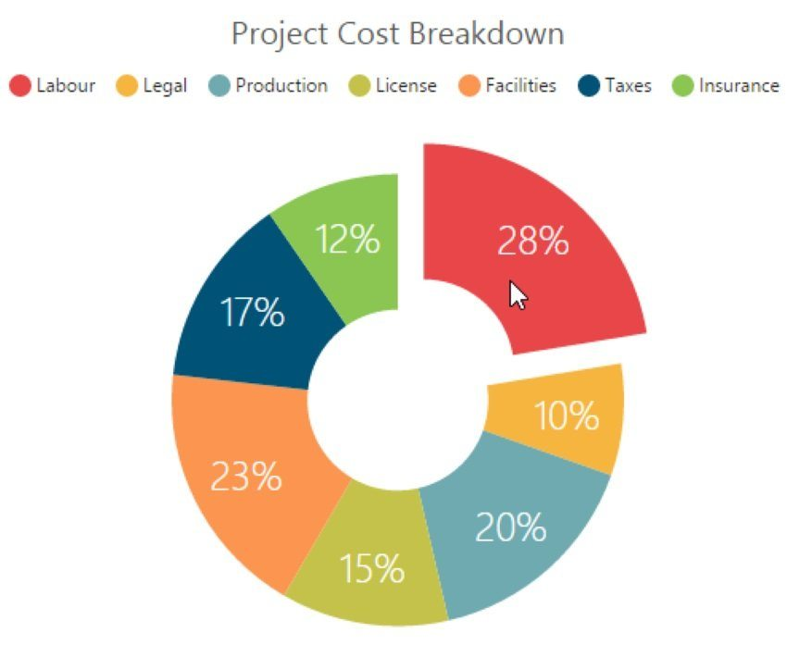
COMPOSITION CHARTS
Donut Chart
What it is: | Pie chart with center removed.
When to use: | Same as pie chart When adding text in the center
Why to use: | More stylish & readable.
Real-life examples: | Customer segment distribution Survey results

Slide 29
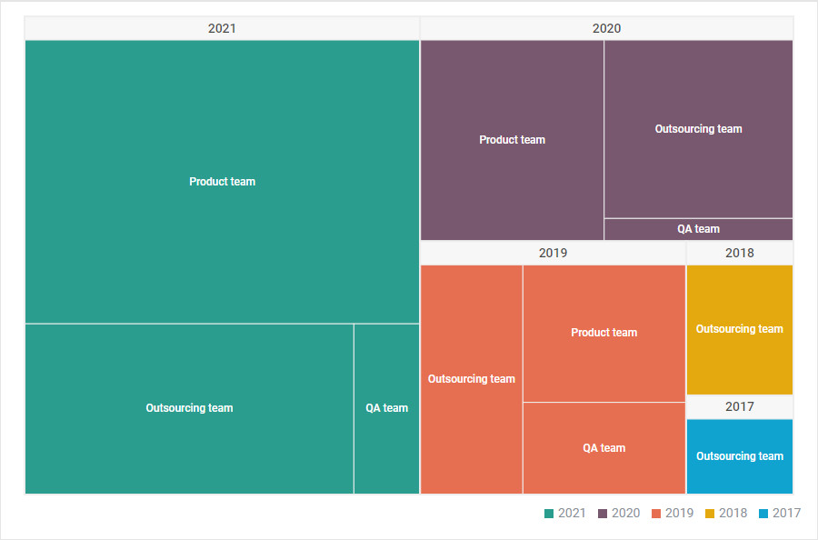
COMPOSITION CHARTS
What it is: | Nested rectangles showing hierarchical data.
When to use: | Show proportions in hierarchical structure.
Why to use: | Shows large datasets compactly.
Real-life examples: | Company → Departments → Teams Product Category Sales

Slide 30
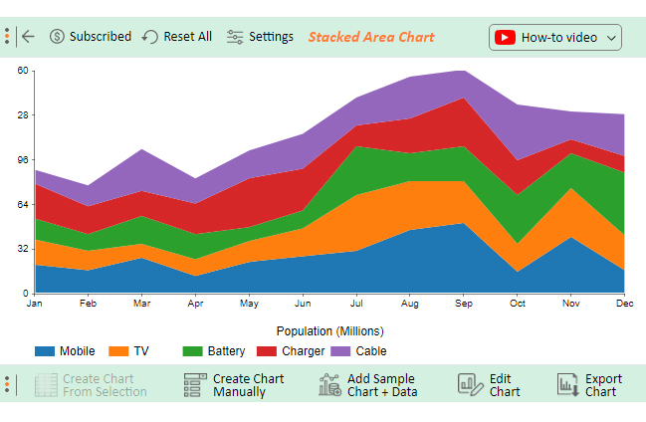
COMPOSITION CHARTS
Stacked Area Chart
What it is: | Area chart showing parts of whole over time.
When to use: | Composition change over time.
Why to use: | Shows cumulative trend.
Real-life examples: | Market share over years Traffic from channels (Organic, Paid, Referral)

Slide 31
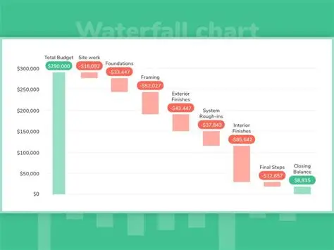
COMPOSITION CHARTS
Waterfall Chart
What it is: | Shows how initial value changes due to additions/subtractions.
When to use: | Financial analysis Tracking step-by-step change
Why to use: | Explains start → end value clearly.
Real-life examples: | Profit breakdown Salary structure Budget breakdown

Slide 32
TREND CHARTS
Line Chart
What it is: | A series of data points connected with lines.
When to use: | Tracking trends over time (days, months, years).
Why to use: | Shows trends, rises, and drops clearly.
Real-life examples: | Stock market price Temperature across months Website traffic over time

Slide 33
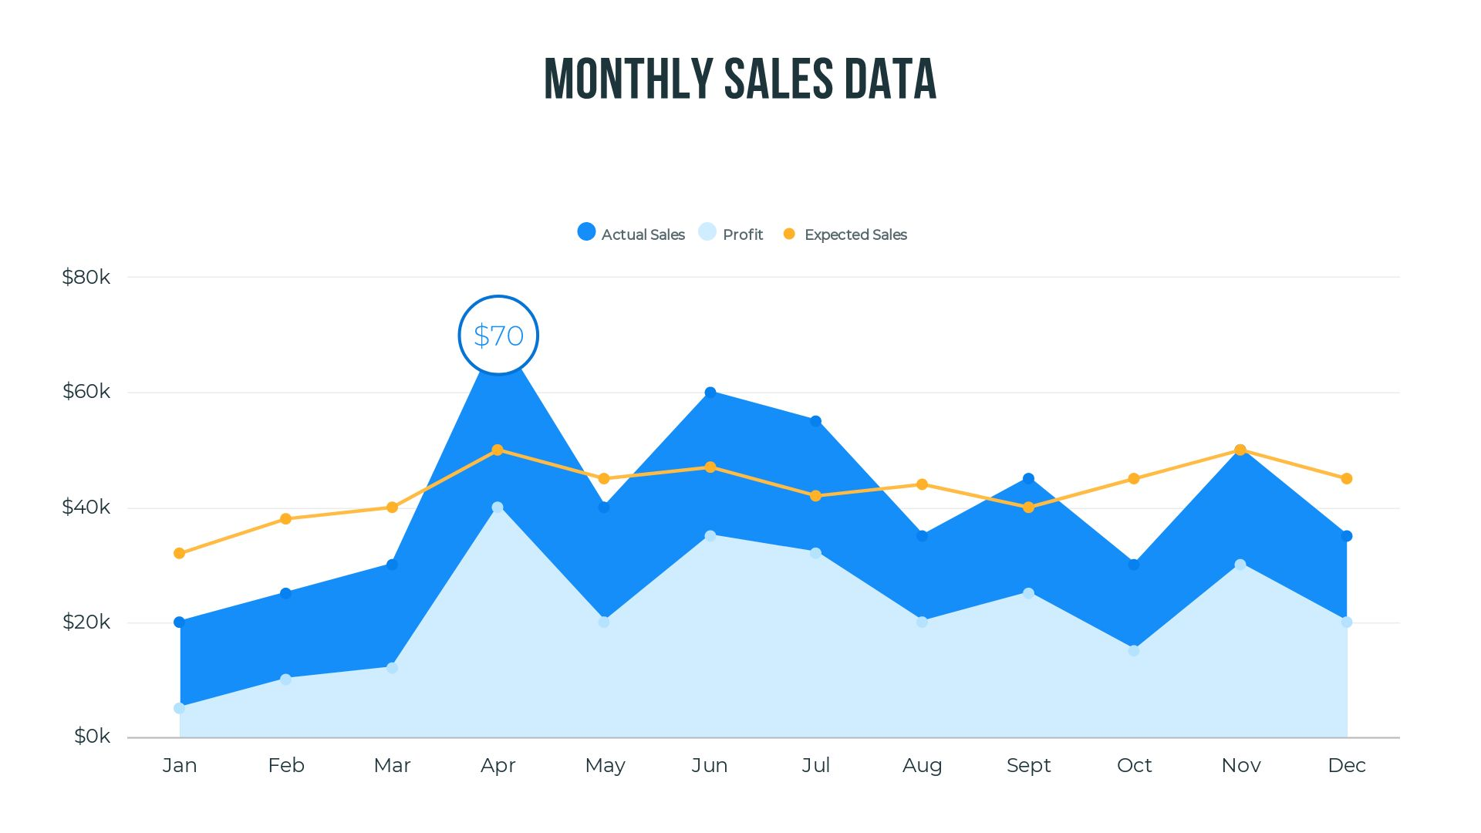
TREND CHARTS
Area Chart
What it is: | Line chart with area filled.
When to use: | Show magnitude + trend Best for cumulative data
Why to use: | Emphasizes volume.
Real-life examples: | Rainfall through year Sales across months

Slide 34
TREND CHARTS
Sparkline
What it is: | Mini line chart inside a cell or dashboard.
When to use: | Compact trend inside tables
Why to use: | Quick mini-trend view.
Real-life examples: | Excel dashboards Website traffic mini charts

Slide 35
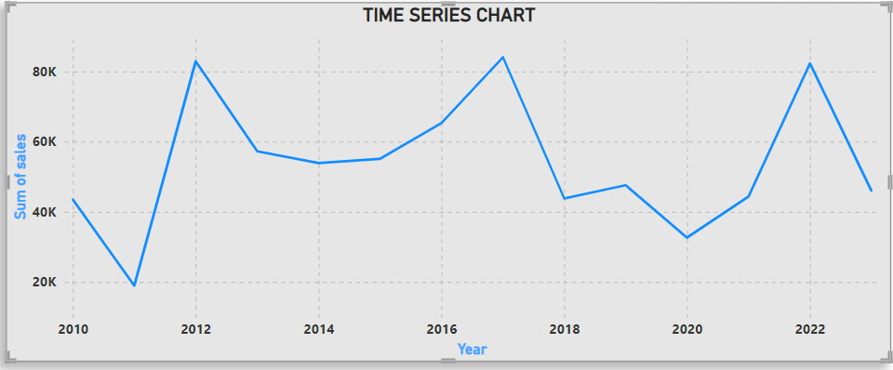
TREND CHARTS
Time Series Chart
What it is: | Any chart showing data over time.
When to use: | Track patterns Forecasting
Why to use: | Shows seasonality & trends.
Real-life examples: | Stock price Monthly revenue Sensor readings

Slide 36
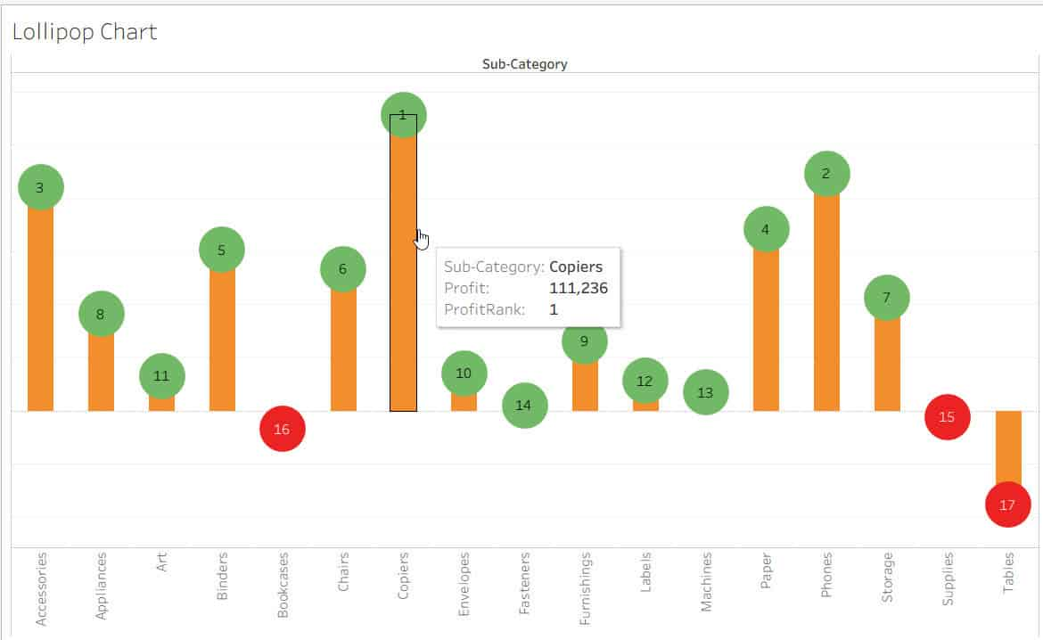
RANKING CHARTS
Lollipop Chart
What it is: | Bar chart but with a dot and stick.
When to use: | Ranking Clean alternative to bar chart
Why to use: | Visually appealing & reduces clutter.
Real-life examples: | Country rankings Top 10 performers

Slide 37
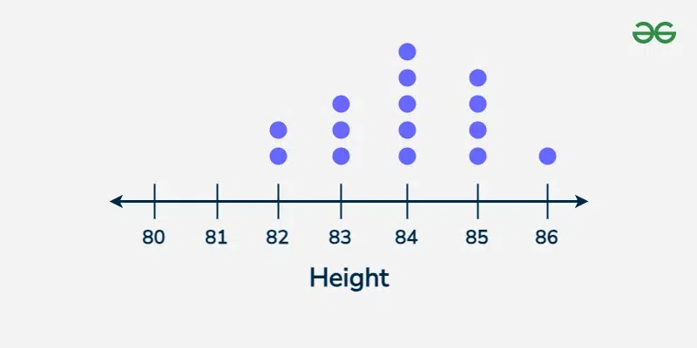
RANKING CHARTS
Dot Plot
What it is: | Dots represent category values..
When to use: | Compare close values Rankings
Why to use: | More precise than bars.
Real-life examples: | Employee rating Product performance

Slide 38
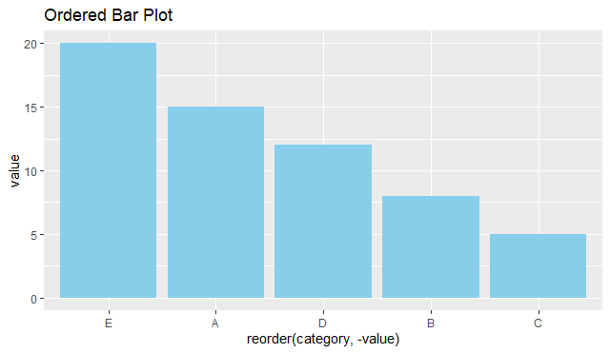
RANKING CHARTS
Ordered Bar Chart
What it is: | Bar chart sorted from high → low.
When to use: | Rankings Top/Bottom analysis
Why to use: | Highlights highest/lowest clearly.
Real-life examples: | Top selling products Most visited webpages

Slide 39
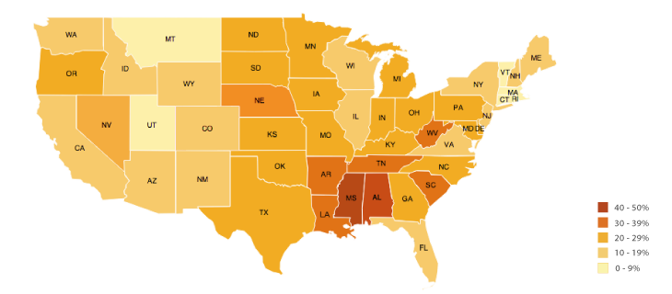
MAPS (Geographical Visualization)
Choropleth Map
What it is: | Map colored by value intensity.
When to use: | Show region-wise values.
Why to use: | Best for country/state comparisons.
Real-life examples: | State-wise population Country-wise GDP

Slide 40
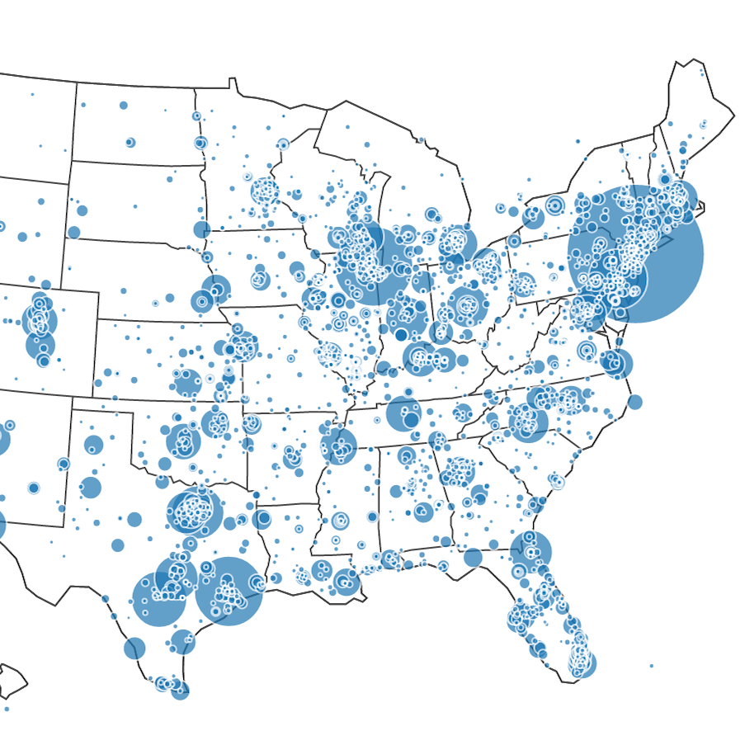
MAPS (Geographical Visualization)
Bubble Map
What it is: | Bubbles placed on geographical locations.
When to use: | Compare quantities at locations.
Why to use: | Easy to see high/low volumes.
Real-life examples: | City-wise sales Airport traffic

Slide 41
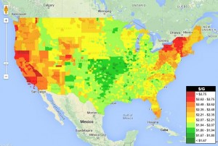
MAPS (Geographical Visualization)
Geo Heatmap
What it is: | Heatmap applied on map.
When to use: | Show density or intensity.
Why to use: | Easier to understand hotspots.
Real-life examples: | Crime density Population density

Slide 42
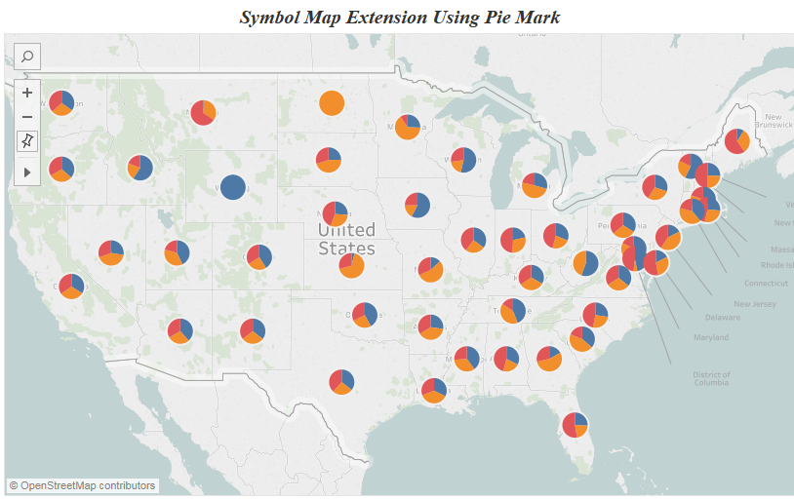
MAPS (Geographical Visualization)
Symbol Map
What it is: | Map with different icons representing data.
When to use: | When categories need symbols.
Why to use: | Visually descriptive.
Real-life examples: | Hospitals, schools, ATMs on map

Slide 43
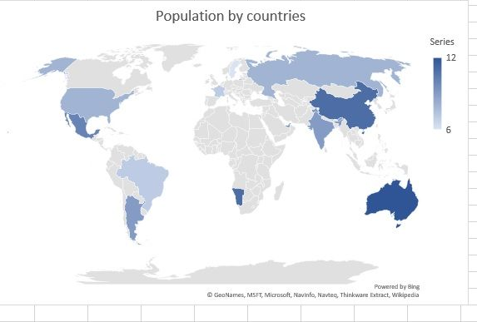
MAPS (Geographical Visualization)
Filled Map
What it is: | Filled areas for countries/states.
When to use: | Comparison between regions..
Why to use: | Clean and simple.
Real-life examples: | State-wise literacy rate

Slide 44
ADVANCED VISUALIZATIONS
Sankey Diagram
What it is:
Flow diagram showing movement from one stage to another.
When to use:
Process flows
Customer journey
Energy or resource flow
Why to use:
Shows transitions beautifully.
Real-life examples:
Website navigation flow
Budget allocation flow
Sunburst Chart
What it is:
Circular hierarchical chart.
When to use:
Show parent → child relationships.
Why to use:
Good for hierarchy depth.
Real-life examples:
Company → Dept → Team
Product category breakdown
Radar / Spider Chart
What it is:
Multi-metric comparison in circular form.
When to use:
Compare performance on multiple criteria.
Why to use:
Shows strengths and weaknesses.
Real-life examples:
Employee skill assessment
Product comparison

Slide 45
ADVANCED VISUALIZATIONS
Funnel Chart
What it is:
Shows decreasing stages.
When to use:
Conversion analysis
Sales funnel
Process drop-off
Why to use:
Shows where users drop out.
Real-life examples:
Leads → Calls → Visits → Conversion
Word Cloud
What it is:
Visual of words sized by frequency.
When to use:
Text analysis
Feedback analysis
Why to use:
Shows most common words quickly.
Real-life examples:
Customer reviews
Social media comments
Network Graph
What it is:
Nodes + links showing relationships.
When to use:
Social networks
Web relationships
Connections
Why to use:
Shows link strength and clusters.
Real-life examples:
Facebook friend network
Website internal link map
Gantt Chart
What it is:
Timeline chart for project management.
When to use:
Project scheduling.
Why to use:
Shows tasks, dates, and progress.
Real-life examples:
Software project plan
Construction timeline

Slide 46
DASHBOARDS & STORYTELLING
A dashboard is not just a collection of charts — it is a story told through visuals. A good dashboard helps users understand data quickly, make decisions, and find insights.
Understand the Purpose
Ask:
Who will use this dashboard?
What decisions do they need to take?
What KPIs matter to them?
Types of Dashboards
Operational Dashboard – real-time updates (e.g., sales today)
Analytical Dashboard – analysis, trends, patterns
Strategic Dashboard – high-level KPIs for leadership

Slide 47
KPI Selection
KPI = Key Performance Indicator KPIs should be:
SMART: Specific, Measurable, Achievable, Relevant, Time-based
Directly related to business goals
Easy to understand
Examples of Good KPIs
Sales
Profit Margin
Customer Acquisition Cost
Conversion Rate
Retention Rate
Attendance %
Productivity Score

Slide 48
TOOLS FOR DATA VISUALIZATION
Excel (Beginner Friendly)
Power BI (Data Visualization + BI)
Tableau (Advanced Visualization)
Python (Matplotlib, Seaborn, Plotly)
Qlik Sense
SAS Visual Analytics
Zoho Analytics( Online)
Infogram

